Slide 1
Refugee Flow:
a Law and Economics approach
Denard Veshi
Supervisors:
Michael G. Faure
Eli M. Salzberger

Slide 2
Overview
Relevance of the Research
Research Questions
Methodology
Contribution to the Literature
Gender and Sex Dimensions
Policy Recommendations
Limits of the Research
Suggestions for Future Research
Denard Veshi – Rotterdam 19.11.2020

Slide 3
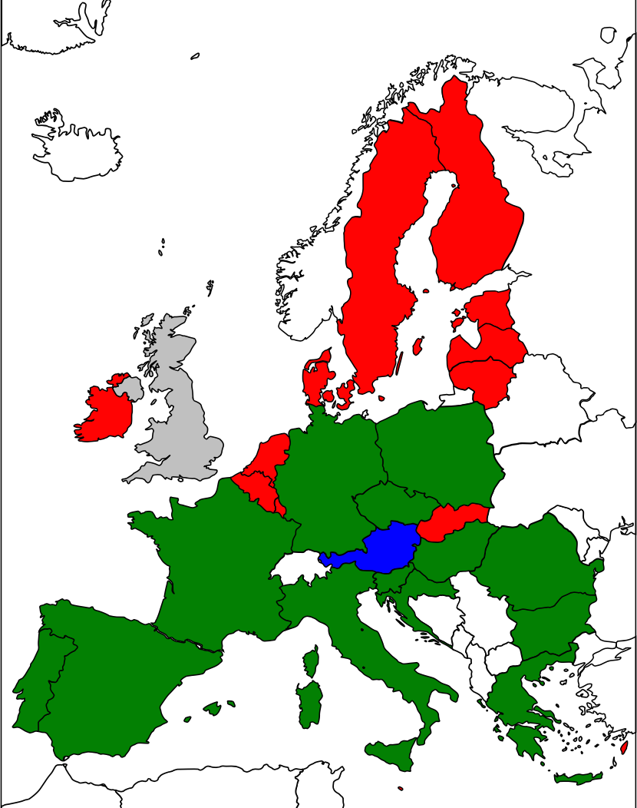
Relevance of the Research
No written constitution
(Brexit)
Absence of the ‘right to asylum’
Mentioning the ‘right to asylum’
Protection of the ‘right to asylum’
Denard Veshi – Rotterdam 19.11.2020

Slide 4
Research Questions
which policy can simultaneously consider the protection of refugee human rights without needlessly damaging the interests of national States?
why do national States ratify and comply with the 1951 Convention?
what are the main variables that affect refugees’ decision-making processes?
what are the most important “push” factors that influence lawmakers when enacting and modifying asylum laws?
which authority shall govern over asylum law, national Parliaments or the EU institutions?
Denard Veshi – Rotterdam 19.11.2020

Slide 5
Methodology
Refugees
$ER\left(0\right)=\int_{0}^{n}{\left\lfloor P_{1}\left(t\right)P_{2}\left(t\right)Y_{d}\left(t\right)−P_{3}\left(t\right)Y_{0}\left(t\right)\right\rfloor }e^{−rt}dt−C(0)$
Protection of national interests
U_{Tot;Net;IL}=(1-p) U_{IL}– p U_{Sanc}
Denard Veshi – Rotterdam 19.11.2020

Slide 6
Contribution to the Literature
innovative interpretation of historical events
eventual positive refugees’ impact on long terms
reasons for the ratification and for the compliance with the 1951 Convention
variables that impact the refugee’s decision to leave and then reside in the final destination countries
refugees’ impact on host countries
advantages and disadvantages of the centralization of asylum law
Denard Veshi – Rotterdam 19.11.2020

Slide 7
Gender and Sex Dimensions
protections of persecuted individuals is the “membership of a particular social group”
LGBTQI community
refugees and impact on national security
female migrants
Denard Veshi – Rotterdam 19.11.2020

Slide 8
Policy Recommendations
some economic variables may have affected the refugee decision process
importance to increase legal opportunities and better integration policies for refugees
Covid-19 and the emergency needs of the agricultural sector in the EU
Denard Veshi – Rotterdam 19.11.2020

Slide 9
Limits of the Research
inclusion of human rights approach
case-law study (Chapter II)
definition of rational choice theory
inclusion of information costs and division of different groups of refugees (Chapter IV)
refugees’ personal decision
not representative data (Chapter IV)
Denard Veshi – Rotterdam 19.11.2020

Slide 10
Suggestions for Future Research
new empirical studies
including the effects of the pandemic situation of 2020
EU quota refugee proposal
quasi-stable outcome
different refugee portion in various EU Member States
suspension of Dublin Regulation
Denard Veshi – Rotterdam 19.11.2020

Slide 11
Denard Veshi
European Doctorate in Law & Economics
Minerva Center for the Rule of Law under Extreme Conditions
denard.veshi@edle-phd.eu
dveshi@campus.haifa.ac.il
Denard Veshi – Rotterdam 19.11.2020

